Slide 1
Child maltreatment – a dental perspective and clinical features
Role of the dentist in child rights’
protection system – good practice
Göran Dahllöf
Department of Dental Medicine
Division of Pediatric Dentistry
Karolinska Institutet

Slide 2
Dental health care a ”new” arena for child protection
2009 2010 2011 2012
Swedish Dental Association, guidelines
Ombudsman for Children in Sweden, survey

Slide 3
Outline of the presentation
Dental care in Sweden
Child abuse and neglect in Sweden
Consequences
Guidelines for dentistry
Child abuse and neglect in undergraduate and continuing dental education

Slide 4
Organization of dental care for children and adolecents
Comprehensive dental care on a regular basis from 3-19 years of age
Public Dental Service 80% of children
Capitation system 100 EUR/child/year
Including specialist treatment in pediatric dentistry and orthodontics
Notes:
Public support and more than 90% visit the dentist every other year

Slide 5
Oral health in children and adolescents - goals
An integral part of general health
A state of sound and well functioning dental and oral structures as well as absence of dental fear and anxiety

Slide 6
Organization of dental care for children and adolescents
Children and adolescents < 19 years, 23% of population
7% of children live in poverty and 25% have immigrant background
Polarization of disease

Slide 7
Decayed and filled teeth in 12-year olds
DFT
2012-06-11
Notes:
Prevalens, av latinets praevalens - överlägsenhet, dominans^{[1]}, är en epidemiologisk term som anger den andel individer i en population som har en given sjukdom eller ett givet tillstånd. Man skiljer mellan prevalensen vid en viss tidpunkt, punktprevalens och prevalensen under en period, periodprevalens^{[2]}.
Incidens, av latinets incidens, perfekt particip av incidere - infalla^{[1]} är ett epidemiologiskt begrepp som anger antalet händelser i en viss population under en avgränsad tid. Händelserna är vanligen nya fall av en sjukdom men kan också vara symptom eller händelser vid en klinisk prövning. Ibland uttrycks incidensen som ett absolut tal (till exempel 500 nya fall av influensa i november), men för att kunna jämföra incidenser är det bättre att den beräknas som en proportion. Beroende på vilka data som finns kan man beräkna två slags incidens^{[2]}.

Slide 8
Change in significant caries index in 12-year olds
1997 2000 2005 2008
2.8 2.7 2.9 2.5
1/3 of population with highest prevalence
Notes:
No significant change in SIC

Slide 9
4-year old children with dental caries
% of children with dental caries
Stecksén-Blicks C et al. Caries Res 2008;18:317-324

Slide 10
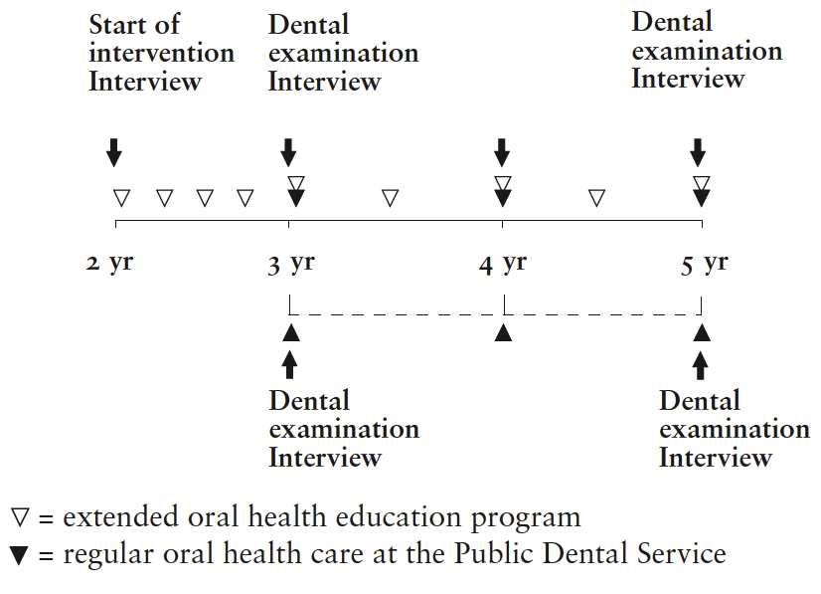
Prevention of dental caries
in a low socio- economic multicultural area
Wennhall et al.

Slide 11
Caries prevalence at 5 years of age
Methods for caries prevention in high risk groups
are not sufficiently effective

Slide 12
Organization of dental care for children and adolescents
Preventive strategy
Individualized recall system
Dental hygienists
Lifestyle diseases

Slide 13
Lifestyle and risk for oral diseases
Obesity and periodontal disease

Slide 14
In dental health care you can meet children who
Tell you in confidence
CASE 1
Notes:
En ung person som lever i en drog miljö, dessutom ett spädbarn

Slide 15
CASE 1
A young woman, 19 years old was referred to pediatric specialist dental care because of toothache, lasted since 1 year, and fear of injection. It was not indicated with oral sedation since she is breastfeeding her son.
Have negative previous experiences with dental care due to pain during procedures. She forces herself to attend at dental appointments.
She grinds her teeth when stressed or angry and she has often problem with headache and severe muscular pain.
The treatment plan is set up, including a splint for the headache and muscular symptoms, treatment regarding the toothache and also cognitive behavior therapy for her dental fear.
During the cognitive behavior therapy she reveals that her boyfriend uses drugs on regular basis at home, also that she has a liberal attitude towards drugs.

Slide 16
Outline of the presentation
Dental care in Sweden
Child abuse and neglect in Sweden
Consequences
Guidelines for dentistry
Child abuse and neglect in undergraduate and continuing dental education

Slide 17
Child maltreatment
when an adult subjects a child to physical or psychological violence, sexual assault, humiliating treatment or fails to meet the child’s basic needs
juni 11, 2012
17
SOU 2001:72 Child abuse- prevention and Protection (in Swedish) 2001.

Slide 18
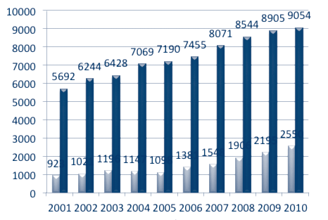
Child abuse reported to
police in Sweden
7-14 yrs
0-6 yrs
BRÅ 2010
Notes:
Number of police reports in 1988 was 1.2 per 1000 children and 6.8 per 1000 children in 2008: increased propensity to report, decreased tolerence to abuse of children or true increase? But probably less frequent. INKLUDERAR VÅLD MELLAN UNGA
Mellan 1990 och 1998 ökade den polisanmälda misshandeln med 114 procent och den fortsätter att öka stadigt (BRÅ 2000). På bilden nedan ser man de markanta ökningarna mellan 2001 – 2010. Eftersom det rör sig om färre anmälningar för förskolebarnen kan man av diagrammet få känslan av att ökningen här inte är så stor som för skolbarnen, men relativt sett är föhållandet faktiskt det omvända med en ökning på 176 procent för barn 0-6 år, jämfört med 62 procent för barn 7-14 år. För båda åldersgrupperna gäller att ökningen är mest markant från år 2006 och framåt.
Ökningen beror främst
på en ökad anmälningsbenägenhet (BRÅ 2009).från Socialtjänst till polis

Slide 19
Canada
Neglect 38%
Physical abuse 28%
Psychological abuse 23%
Sexual abuse 9%
United Kingdom
Neglect 44%
Physical abuse 15%
Psychological abuse 23%
Sexual abuse 7%
Sweden
Neglect 1.4% ¹
Physical abuse 15%²
Sexual abuse 3-10%³
USA
Neglect 60%
Physical abuse 10%
Psychological abuse 11%
Sexual abuse 7%
Australia
Neglect 34%
Physical abuse 28%
Psychological abuse 34%
Sexual abuse 10%

Slide 20
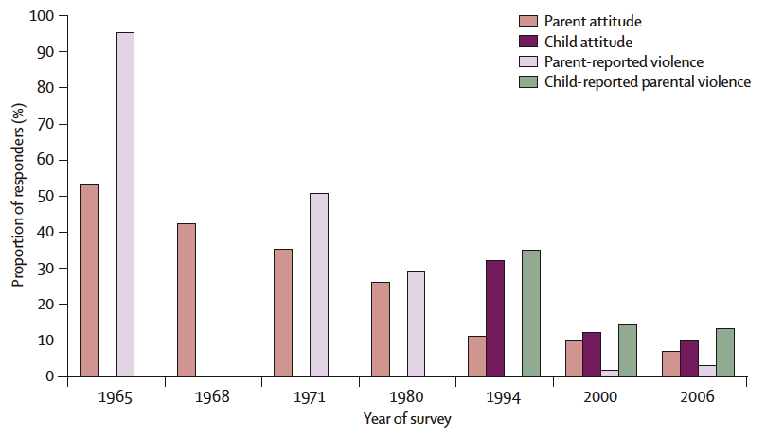
Time trends in parental violence towards children in Sweden
Notes:
Responses are to the question “Is it right to punish your child physically (including a box on the ear) if they have made you angry” (for children “Is it OK for your parents to hit you if you have made them angry?”).

Slide 21
Time trends in parental violence towards children in Sweden
92% have negative opinion to corporal punishment
3% states that they have hit their child at least once
Notes:
Responses are to the question “Is it right to punish your child physically (including a box on the ear) if they have made you angry” (for children “Is it OK for your parents to hit you if you have made them angry?”).

Slide 22
Time trends in parental violence towards children in Sweden
14% of adolescents report abuse, 3% on repeated occations
Children with chronic diseases or disability and born abroad risk factors
Intimate partner violence related to child physical abuse
Notes:
Responses are to the question “Is it right to punish your child physically (including a box on the ear) if they have made you angry” (for children “Is it OK for your parents to hit you if you have made them angry?”).

Slide 23
Accumulation of risk factors for child physical abuse
A person with a tendency to use violence in conflict situations
A high level of stress on the perpetrator and the family which removes barriers
A child who can not protect himself or whose behavior implies extreme stress on the parents
Insufficient social network that does not manage to protect the child
Annerbäck et al. J Fam Viol 2010;25:165-72
Notes:
Factors associated with the perpetrators: gender, addiction/mental disorder, parental intimate parter violence , parents own history of abuse as child, parental support for corporal punishment
Family stress: social and economic condition, minority groups
Factors associated with the child: Age (young), disability/chronic disease, behavioral problems

Slide 24
Corporal punishment and other humiliating behavior towards children in Sweden
The increase in cases reported to the police reflects more frequent reports of neglect
Nine out of ten parents state that it is wrong to spank children
Notes:
Swedish parents seem to have stopped shaking their infants

Slide 25
Corporal punishment and other humiliating behavior towards children in Sweden
Family violence is the most dangerous risk factor for child abuse
Corporal punishment affects children’s life negatively in many ways
No major changes in later years

Slide 26
Outline of the presentation
Dental care in Sweden
Child abuse and neglect in Sweden
Consequences
Guidelines for dentistry
Child abuse and neglect in undergraduate and continuing dental education

Slide 27
Consequences of child abuse and deglect
Physical health problems
Mental health problems
Low educational achievment
Drug and alcohol misuse
Adverse social behaviors
Death
Gilbert et al. Lancet 2009;373:68-81
Miller and Chen 2011

Slide 28
Tentative model for early childhood stress and disease
Notes:
Markers of inflammation are elevated in persons exposed to childhood stress, even when they reach older ages
Childhood stress programs monocytes/macrophages to have proinflammatory tendencies
Adults display heightened cytokine respons to microbial stimuli and are less sensitive to cortisol that shut down this process

Slide 29
Outline of the presentation
Dental care in Sweden
Child abuse and neglect in Sweden
Consequences
Guidelines for dentistry
Child abuse and neglect in undergraduate and continuing dental education

Slide 30
Why should dental professionals be involved in child protection
Child abuse and neglect are prevalent
Most cases are unreported
Dentistry meets children on a regular basis
Difficult question for interested in childrens well-being
Few reports from health presonnel
Notes:
Only 4% of reports to child-protections services comes from health-care

Slide 31
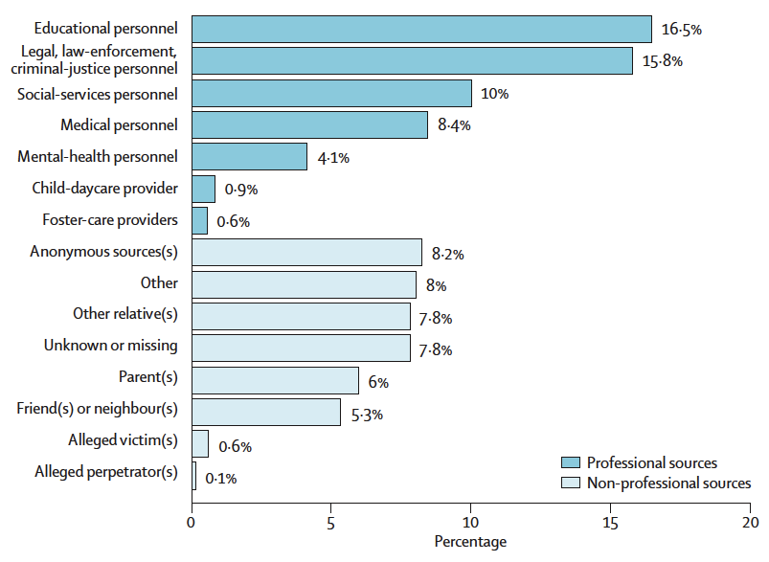
Sources of reports to child protection servicces in the USA
Gilbert R et al. Lancet 2009;373:167-80

Slide 32
Why should dental professionals be involved in child protection
Mandated reporting
Oral and dental injuries
Plaque and gingivitis
Untreated caries
Dental fear and anxiety
Behavior management problems
Naidoo S. Child abuse negl 2000;24(4) 521-34
Greene et al. Mil Med 1995;160(6):290-293
Gustafsson et al. Int J Paediatr Dent 2007;17:449-459.

Slide 33
Responsibilities for dental professionals
Observe and recognize
Be a part of the puzzle
Communicate
Do not diagnose

Slide 34
Child abuse – multi-professional responsibility
Dental team
Medical team
Social services
- gathers all information
Psychological
and psychiatric experts
Legal system
Social network
School and daycare
Notes:
Child abuse is a multiprofessional responsibility. The social services can receive informtion from different sources around the child, including from the dental team. In reality this communication not always work.Several studies has found that dental professionals are rarely referred to in cases of abuse, at the same time as dental professionals fails to report suspected abuse and neglect. The dental team themselves askes for a better cooperation with especially the social services.
In order to improve the communication between the different actors, including the dental team we must find ways that are easy for all involved to use.

Slide 35
Developments in Sweden child protection and dentistry
Ombudsman for Children in Nordic countries, meeting
Research
Multiprofessional cooperation
2009 2010 2011 2012
www.cpdt.org.uk, translation
Swedish Dental Association, guidelines
Ombudsman for Children in Sweden, survey

Slide 36
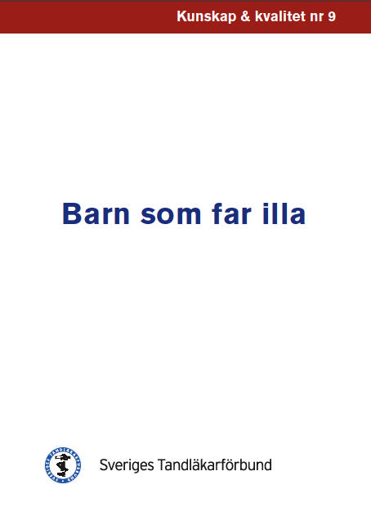
Swedish Dental Association
Mandated reporting
How to file a report
Definitions
When a child miss appointments
Templates
Report to social services
Letter to parents

Slide 37
When parents do not take their children to dental care
Make appointment
Fail to show up – new appointment
Personal call to guardian
No personal contact – write a letter
Fail to show up – repeat after 3 months
After 12 months inform about mandatory reporting

Slide 38
Letter to parent
NN has had several appointments with us, but has not showed up. We have tried to reach you as the legal guardian but not succeded. According to Swedish law all children have the right to dental care to support their health and development.
Since NN has not been here for an extended period of time we can not assess his/her treatment needs.
When suspicion regarding a child’s well-being arise, we are mandated to contact the social services.
I would like you to contact us as soon as possible so we can discuss regarding NN dental care.

Slide 39
Kvist et al. Swed Dent J 2012;36:15-23
Management of suspected abuse and neglect in public dental service
30% of the clinics in public dental service had filed a report to the social services
Regional differences
Multiple missed appointments is common
Knowledge, eduaction and multiprofessional cooperation are essential
Namn Efternamn
juni 11, 2012
39

Slide 40
Guidelines on abuse
and neglect
Kvist et al. Swed Dent J 2012;36:15-23

Slide 41
Assumed reasons why parents fail to bring their child to dental appointments

Slide 42
Clinical guidelines on child abuse and neglect
Those who had guidelines made reports or contacted the social services more often
Not effective to only schedule a new appointment
Not show up for examination – dental neglect
Kvist et al. Swed Dent J 2012;36:15-23

Slide 43
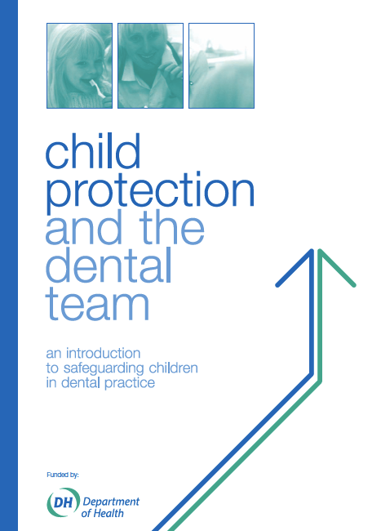
www.cpdt.org.uk
2006
Handbook and website
Committee of Postgraduate Dental Deans and Directors
Good illustrations
Possible to translate

Slide 44
Outline of the presentation
Dental care in Sweden
Child abuse and neglect in Sweden
Consequences
Guidelines for dentistry
Child abuse and neglect in undergraduate and continuing dental education

Slide 45
Child abuse and neglect in undergraduate and continuing dental education
Not mandatory in dental and medical education
Curriculum guidelines
Continuing education further enhances the chance to report all suspicious injuries
Those who have had training more often file reports to social services
Intermittent and continuous education is required to follow this progress
Notes:
Unfortunately, education and training in child protection is not standard for health professionals in Sweden (?). Several studies report that few dental professionals and pediatricans can recall any form of education in child protection and mandated reporting (Harris et al 2009, Mårtensson och Jansson 2010, Chadwick et al 2009). The educational curricula on child protection is comparative to that on domestic violence. Chiodo GT et al JADA 1994) reported that less than 10 percent of dentists and dental hygienists had received any training regarding violence in close relations. Professionals who have had some education are more likely to report suspected abuse than practitioners who lack this knowledge and to have had received continuing education further enhances the chance to report all suspicious injuries (Flaherty 2000, Harris et al 2009). A curriculum developed by The Council on Medical Student Education I Pediatrics (COMSEP) is used by US and Canadian educators for undergraduate education in pediatrics. It includes prerequisites, competencies and clinical questions for discussion regarding child abuse and neglect. Research is continuously conducted and the knowledge of child abuse is expanding . Intermittent and continuous education is required to follow this progress and the purpose with education should aim at preparing the students for the situations they will face during their career.
Barnskydd håller väl inte tandläkare på med?
ibid
in the curriula?

Slide 46
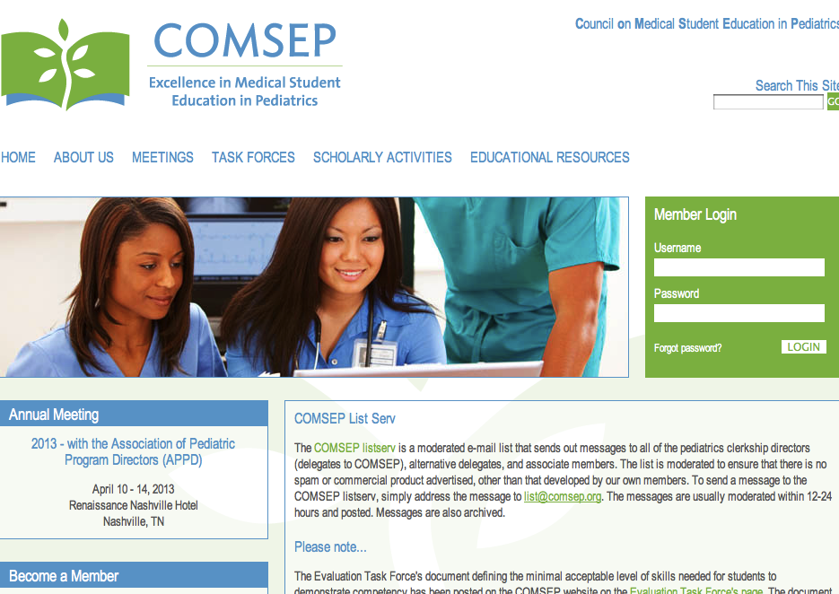
Curriculum guidelines

Slide 47
Competencies
List characteristics of the history and physical examination that should trigger concern for possible physical, sexual, and psychological abuse and neglect Describe the medical-legal importance of a full, detailed, carefully documented history and physical examination in the evaluation of child abuse. (CP)
Discuss the concurrence of domestic violence and child abuse and describe markers that suggest the occurrence of family violence. (U)
Describe the unique communication skills required to work with families around issues of maltreatment. (M)
Summarize the responsibilities of the "mandatory reporter" to identify and report suspected child abuse. Know to whom such a report should be made. (M
Notes:
e.g. such as inconsistency in the history, unexplained delays in seeking care, injuries with specific patterns or distributions on the body, or injuries incompatible with the child's development. (CP)

Slide 48
Child abuse and neglect in undergraduate and continuing dental education
Not mandatory in dental and medical education
Curriculum guidelines
Continuing education further enhances the chance to report all suspicious injuries
Those who have had training more often file reports to social services
Intermittent and continuous education is required to follow this progress
Notes:
Unfortunately, education and training in child protection is not standard for health professionals in Sweden (?). Several studies report that few dental professionals and pediatricans can recall any form of education in child protection and mandated reporting (Harris et al 2009, Mårtensson och Jansson 2010, Chadwick et al 2009). The educational curricula on child protection is comparative to that on domestic violence. Chiodo GT et al JADA 1994) reported that less than 10 percent of dentists and dental hygienists had received any training regarding violence in close relations. Professionals who have had some education are more likely to report suspected abuse than practitioners who lack this knowledge and to have had received continuing education further enhances the chance to report all suspicious injuries (Flaherty 2000, Harris et al 2009). A curriculum developed by The Council on Medical Student Education I Pediatrics (COMSEP) is used by US and Canadian educators for undergraduate education in pediatrics. It includes prerequisites, competencies and clinical questions for discussion regarding child abuse and neglect. Research is continuously conducted and the knowledge of child abuse is expanding . Intermittent and continuous education is required to follow this progress and the purpose with education should aim at preparing the students for the situations they will face during their career.
Barnskydd håller väl inte tandläkare på med?
ibid
in the curriula?

Slide 49
Gaps of knowledge
How do abuse and neglect affect oral and dental health in children and adolescents
How can we improve multiprofessional communication?
What are the barriers and challenges to identify and report abused and neglected children in dentistry
Notes:
There are still gaps of knowedge, even though we have seen in previous studies that abused children have more untreated caries and oral and dental injuries are frequently seen in pysically abused children we do not know how abuse really affect the oral and dental health. Do all abused and neglected children have a higer risk of dental disease? What can the dental team add at an early stage, is a untreated caries indicative of abuse or neglect? We need to find out the association between dental disaese and abuse, we need to improve multiprofessional communication and we also need to understand the barriers the dental professionals meets in the clinical situation. If we get answers to these three questions it will be easier to develop cost-concious guidelines and educational programmes and also care programes for abused children and adolescents.

Slide 50
How can the dental team be a part of the puzzle?
Improve collaboration between professionals
Child protection in undergraduate and continuing education
Establish dental care programmes for abused and neglected children
Multiprofessional research is required

Slide 51
goran.dahllof@ki.se

