Slide 1
Child abuse and neglect- dental aspects and clinical features
Role of the dentist in child rights’
protection system – good practice
Therese Kvist
Department of Dental Medicine
Division of Pediatric Dentistry
Karolinska Institutet

Slide 2
Pediatric dentists meets children with special needs
Chronical conditions
Uncontrolled dental disease
Traumatic injuries
Behavior management problems
Klingberg G et al 2010 Sep 1;20(5):313-21

Slide 3
Child abuse and neglect-Dental responsibilities
Mandated to report suspicions on child abuse and neglect
Observe
Recognize
Communication with other actors

Slide 4
Social services act in Sweden
..health care services have a duty to immediately report to the Social Services if, in the course of their work, they have reason to suspect that a child or adolescent is in need of the protection of the Social Services
The Social Services should be notified even if there is only a suspicion that a child needs protection

Slide 5
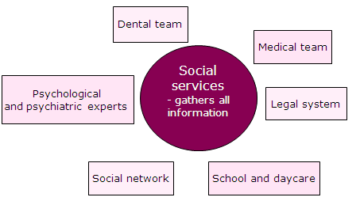
Social services in Sweden- How does it work?
Suspicion
Previous reports?
Reporter
Based on the seriousness in report
Decision on investigation
Report
Namn Efternamn
11 juni 2012
5

Slide 6
Gathering of information
Childs need in focus
Health
Education
Development
Identity
Family/Social network
Social behavior
Coping
Basic needs
Security
Emotional care
Developmental possibilities
Guidance
Stability
Childs needs
Parental abilities
CHILD
Family and environment
Family background
Network
Living situation
Economical situation
Intergration
Social interactions

Slide 7
Child abuse - a multiprofessional responsibility
Dental team
Medical team
Social services
- gathers all information
Psychological
and psychiatric experts
Legal system
Social network
School and daycare

Slide 8
Dental responsibilities
Mandated to report suspicions on child abuse and neglect
Observe
Recognize
Communicate with other actors
Do not diagnose

Slide 9
Do not diagnose
You only report your concern
Social services investigate if the child needs protection or help
The police investigate if a crime has been committed
The prosecutor take the case to court when necessary

Slide 10
Previous knowledge
Oral and dental injuries
Untreated caries
Behavior management problems
Plaque and gingivitis
Naidoo S. Child abuse negl 2000;24(4) 521-34
Gustafsson et al. Int J Paediatr Dent 2007;17:449-459

Slide 11
Gaps of knowledge
How do abuse and neglect affect oral and dental health in children and adolescents
How can we improve multiprofessional communication?
What are the barriers and challenges to identify and report abused and neglected children in dentistry

Slide 12
Observe and recognize- deviations from the normal spectra
Lykke K et al Family Practice 2008;25:146-153

Slide 13
Trauma or abuse?
Changing or inconsistent history
Delay in presentation
Previous concerns, including siblings
Dental examination
Injuries
Notes:
To distinguish physical abuse from a normal trauma there are some important hallmarks that always should be considered whenever a child enters the dental clinic with a traumatic injury.
What is the story behind? If it is a older child that can speak for themselves- do the parents history and the childs history coincide? Do they change their story when they repeat it? When did the trauma happen? Today? Yesterday or a week ago? Severe injuries like fractures and displacement of teeth should require immediate dental care. Smaller injuries can be ok to be somewhat delayed.
Further, is this a repeated trauma? Does this child seek care often because of trauma, or are there any siblings in the family that often are hurt?
The dental examiniation and diagnosis should always be considered together with the story told. For example; Is this fracture likely to have been caused by that fall to the ground? The site and extent of the injuries can also be suggestive of the cause of the trauma.

Slide 14
Sexual abuse
Bruises and petechier in palatinal mucosa
Extreme dental fear
Veneric disease
Willumsen T. Eur J Oral Sci 2001;109: 291-296

Slide 15
Important note
Suspicions of physical abuse or sexual abuse should not be discussed with the parents before contacting the social services

Slide 16
Emotional abuse
Dental behavior managment problems?
Unrealistic expectations
Ignorance of the child
Physical abuse and intimate partner violence
www.cpdt.org

Slide 17
Neglect
Nutrition
Inappropriate clothing
Safe environment
Hygiene and health-care
Stimulation and education
Withdrawn or attention seeking behaviour
Kellog N. Pediatr Dent Ref Manual 2009;31(6):11
www.cpdt.org

Slide 18
When is it dental neglect?
- a willful failure of parent or guardian to seek and follow through with treatment necessary to ensure a level of oral health essential for adequate function and freedom from pain and infection
Kellog N. Pediatr Dent Ref Manual 2009;31(6):11

Slide 19
Assessing dental neglect
The multi-factorial causation of dental caries
Variation in individual susceptibility to dental disease
Differences in the treatment dentists provide
Inequalities in dental health
Inequalities in access to dental services
www.cpdt.org

Slide 20
Why parents fail to bring their children to dental appointments
Overload in daily life
Lack of dental
traditions
in the family
Poor parental confidence in dental situations
Lack of trust to healthcare services
Therese Hallström Socialstyrelsen 22 juni 2010Namn Efternamn
Hallberg et al. Int J Paediatr Dent 2008;18:27-34

Slide 21
Important note
Support the parents
Information
Provide dental utilities; toothbrush, toothpaste
Use interpreters
Give the parents tools to help their children
www.cpdt.org

Slide 22
When should we alert the social services?
Poor SPOH
Dental fear
Poor oral hygiene
Substance misuse
General anesthesia
One factor?
Multiple factors?
Extensive caries in low age
Repeated cancellations/failure to attend
BMP

Slide 23
Gaps of knowledge
How do abuse and neglect affect oral and dental health in children and adolescents
How can we improve multiprofessional communication?
What are the barriers and challenges to identify and report abused and neglected children in dentistry

Slide 24
Do dental specialists neglect dental neglect?
81% meet a neglected dentition more than once a week
23/27 specialist dental clinics in Sweden meets dental neglect on regular basis
Harris et al Br Dent J. 2009 May 9;206(9):465-70
Klingberg G. Aktuell nordisk odontologi 2010;195-208.

Slide 25
How do other professionals deal with this issue?
” This is not normal”
Difficulties in recording suspected abuse in medical journals
Lottery
Lykke et al Family Practice 2008;25:146-153
Van Haeringen et al Child Abuse Negl 1998;22:159-69

Slide 26
Reasons for not reporting among dental professionals
Uncertainty of diagnosis
Unfamiliarity with routines
Concern of causing a problem/distress
Concern of own safety
Not my responsibility

Slide 27
In Sweden?
Kvist et al. Swed Dent J 2012; 36: 15-23

Slide 28
A suspicion-
are there ways to make easier?
Use of numerical estimations
What are the
chances that
this is abuse?
>25% chance that abuse occurred
→2-3 times higher rate of reporting
Levi et al. J Law Med Ethics 2011;39(1):62-9

Slide 29
A suspicion-
are there ways to make easier?
2) Rank abuse as a differential diagnosis
Fifth differential diagnosis (20%) indicate reasonable suspicion
Estimated probability
50-60% indicate reasonable
suspicion
Levi et al. J Law Med Ethics 2011;39(1):62-9

Slide 30
Oral health in children and adolescents - goals
An integral part of general health
A state of sound and well functioning dental and oral structures as well as absence of dental fear and anxiety
All dental care based on the needs of the individual child

Slide 31
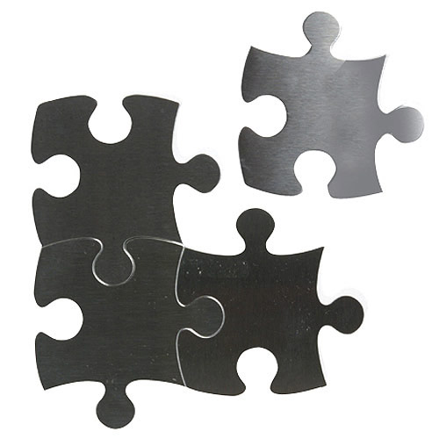
How can the dental team be a part of the puzzle?
Improve collaboration between professionals
Establish dental care programmes for abused and neglected children
Establish undergraduate and postgraduate continious education
Multiprofessional research is required

